Slide 1
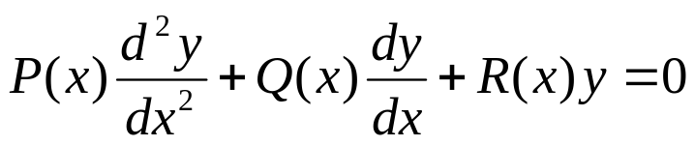
Ch 5.4: Euler Equations;
Regular Singular Points
Recall that for equation
if P, Q and R are polynomials having no common factors, then the singular points of the differential equation are the points for which P(x) = 0.

Slide 2


Example 1: Bessel and Legendre Equations
Bessel Equation of order ν:
The point x = 0 is a singular point, since P(x) = x² is zero there. All other points are ordinary points.
Legendre Equation:
The points x = ±1 are singular points, since P(x) = 1- x² is zero there. All other points are ordinary points.

Slide 3

Euler Equations
A relatively simple differential equation that has a singular point is the Euler equation,
where α, β are constants.
Note that x₀ = 0 is a singular point.
The solution of the Euler equation is typical of the solutions of all differential equations with singular points, and hence we examine Euler equations before discussing the more general problem.

Slide 4





Solutions of the Form y = x^{r}
In any interval not containing the origin, the general solution of the Euler equation has the form
Suppose x is in (0, ∞), and assume a solution of the form y = x^{r}. Then
Substituting these into the differential equation, we obtain
or
or

Slide 5

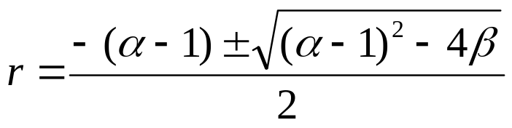
Quadratic Equation
Thus, after substituting y = x^{r} into our differential equation, we arrive at
and hence
Let F(r) be defined by
We now examine the different cases for the roots r₁, r₂.

Slide 6

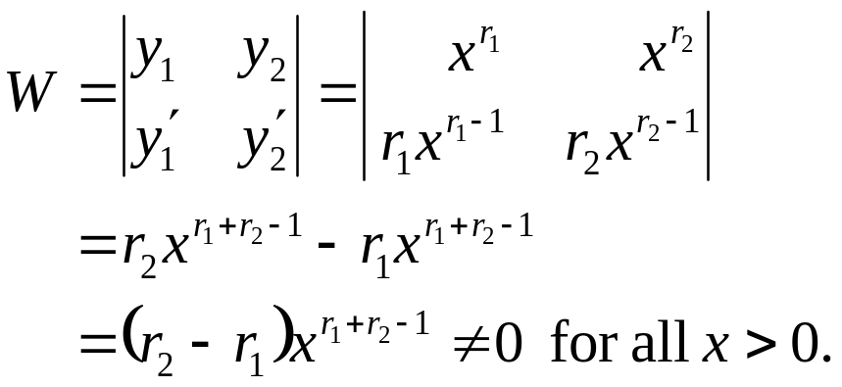

Real, Distinct Roots
If F(r) has real roots r₁ ≠ r₂, then
are solutions to the Euler equation. Note that
Thus y₁ and y₂ form fundamental solutions, and the general solution to our differential equation is

Slide 7
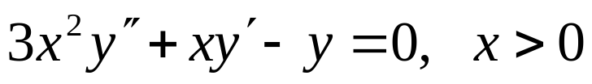
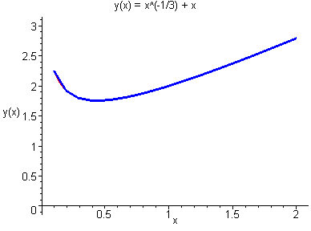
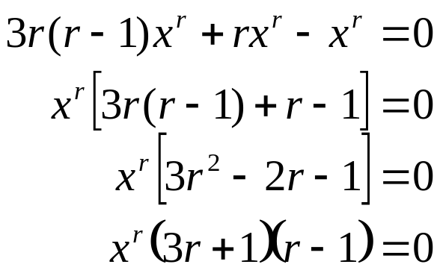

Example 1
Consider the equation
Substituting y = x^{r} into this equation, we obtain
and
Thus r₁ = -1/3, r₂ = 1, and our general solution is

Slide 8

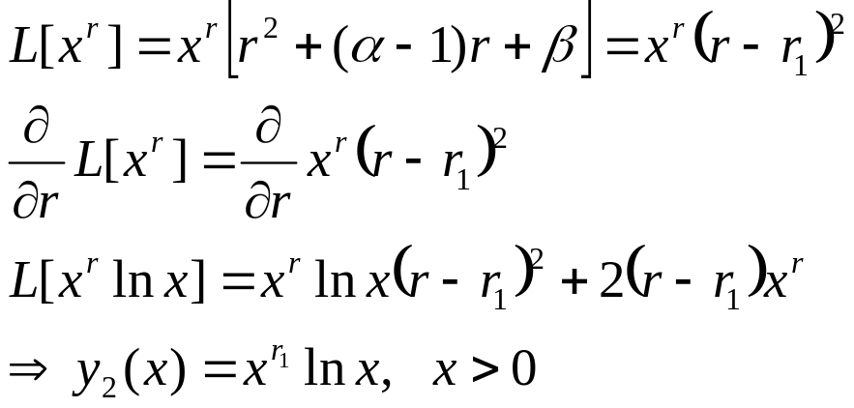
Equal Roots
If F(r) has equal roots r₁ = r₂, then we have one solution
We could use reduction of order to get a second solution; instead, we will consider an alternative method.
Since F(r) has a double root r₁, F(r) = (r - r₁)², and F'(r₁) = 0.
This suggests differentiating L[x^{r}] with respect to r and then setting r equal to r₁, as follows:

Slide 9

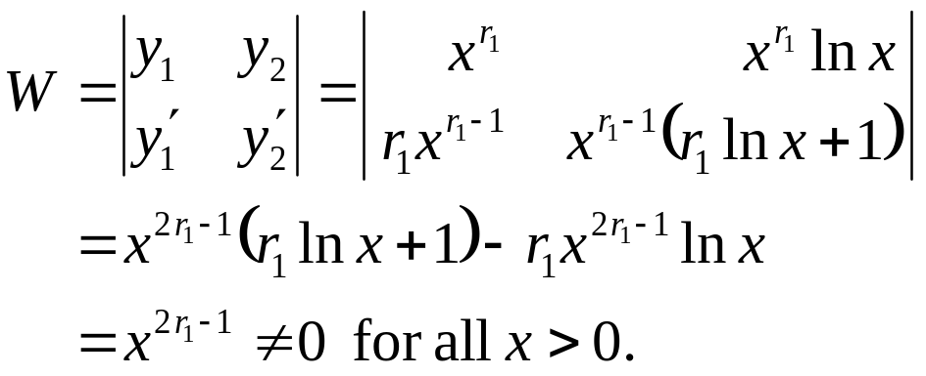
Equal Roots
Thus in the case of equal roots r₁ = r₂, we have two solutions
Now
Thus y₁ and y₂ form fundamental solutions, and the general solution to our differential equation is

Slide 10

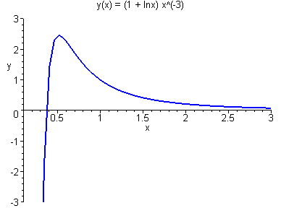
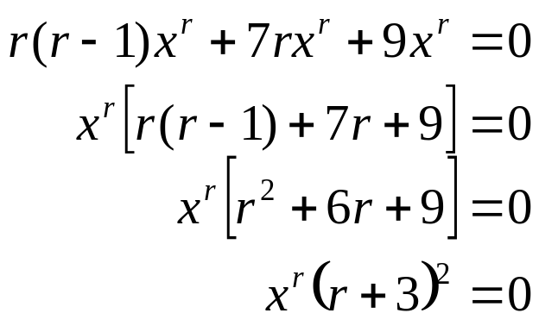

Example 2
Consider the equation
Then
and
Thus r₁ = r₂ = -3, our general solution is

Slide 11
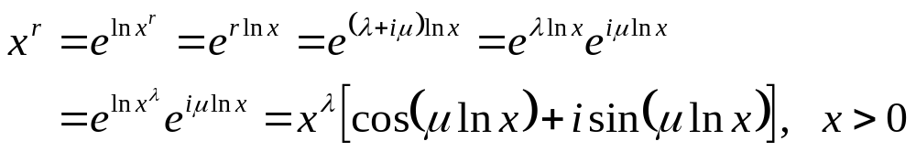

Complex Roots
Suppose F(r) has complex roots r₁ = λ + iμ, r₂ = λ - iμ, with μ ≠ 0. Then
Thus x^{r} is defined for complex r, and it can be shown that the general solution to the differential equation has the form
However, these solutions are complex-valued. It can be shown that the following functions are solutions as well:

Slide 12
Complex Roots
The following functions are solutions to our equation:
Using the Wronskian, it can be shown that y₁ and y₂ form fundamental solutions, and thus the general solution to our differential equation can be written as

Slide 13
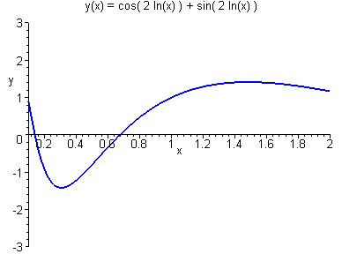

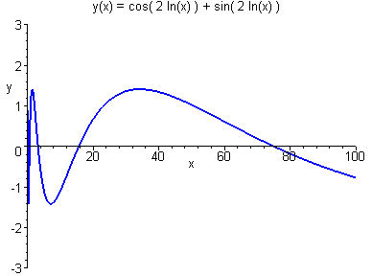
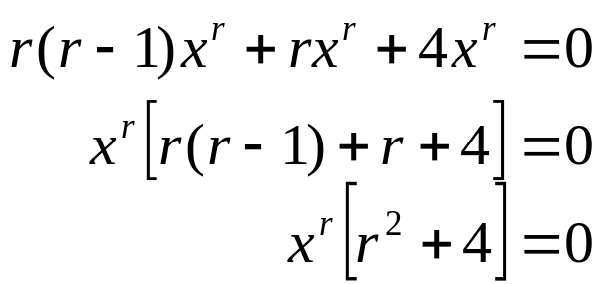
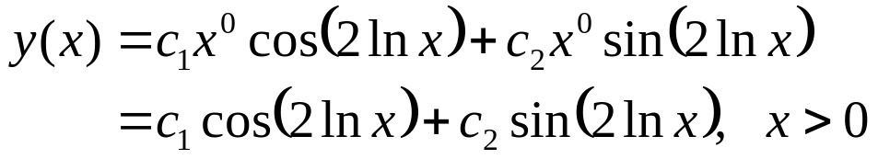
Example 3
Consider the equation
Then
and
Thus r₁ = -2i, r₂ = 2i, and our general solution is

Slide 14
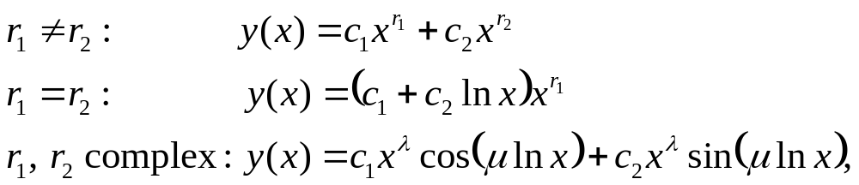
Solution Behavior
Recall that the solution to the Euler equation
depends on the roots:
where r₁ = λ + iμ, r₂ = λ - iμ.
The qualitative behavior of these solutions near the singular point x = 0 depends on the nature of r₁ and r₂. Discuss.
Also, we obtain similar forms of solution when x < 0. Overall results are summarized on the next slide.

Slide 15

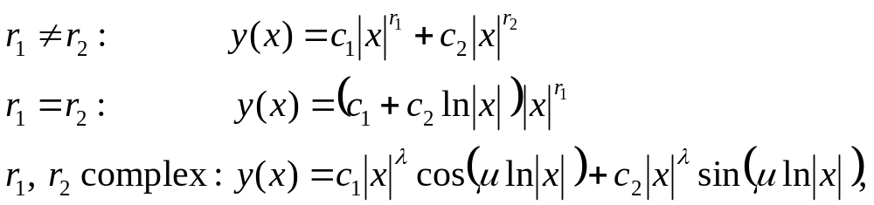
General Solution of the Euler Equation
The general solution to the Euler equation
in any interval not containing the origin is determined by the roots r₁ and r₂ of the equation
according to the following cases:
where r₁ = λ + iμ, r₂ = λ - iμ.

Slide 16
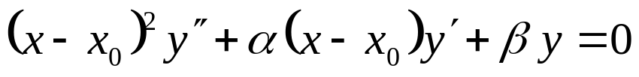
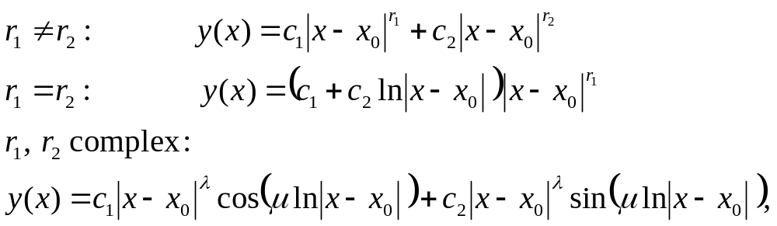
Shifted Equations
The solutions to the Euler equation
are similar to the ones given in Theorem 5.5.1:
where r₁ = λ + iμ, r₂ = λ - iμ.

Slide 17
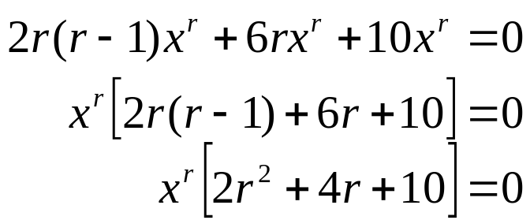
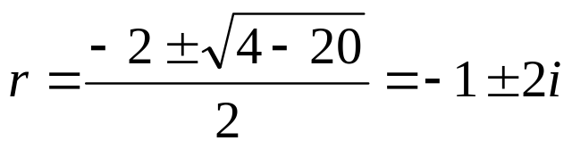
Example 5: Initial Value Problem (1 of 4)
Consider the initial value problem
Then
and
Using the quadratic formula on r² + 2r + 5, we obtain

Slide 18
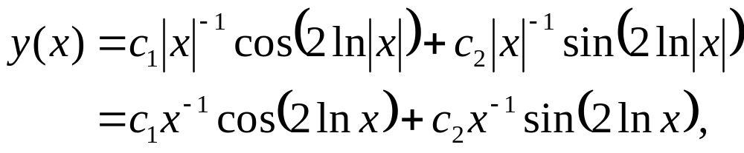
Example 5: General Solution (2 of 4)
Thus λ = -1, μ = 2, and the general solution of our initial value problem is
where the last equality follows from the requirement that the domain of the solution include the initial point x = 1.
To see this, recall that our initial value problem is

Slide 19
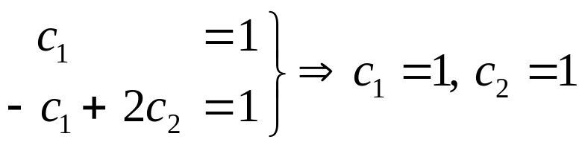

Example 5: Initial Conditions (3 of 4)
Our general solution is
Recall our initial value problem:
Using the initial conditions and calculus, we obtain
Thus our solution to the initial value problem is

Slide 20
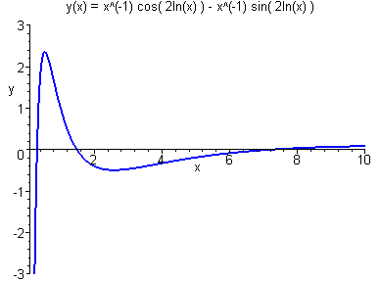
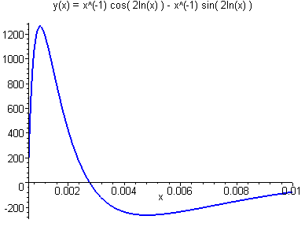
Example 5: Graph of Solution (4 of 4)
Graphed below is the solution
of our initial value problem
Note that as x approaches the singular point x = 0, the solution oscillates and becomes unbounded.

Slide 21
Solution Behavior and Singular Points
If we attempt to use the methods of the preceding section to solve the differential equation in a neighborhood of a singular point x₀, we will find that these methods fail.
Instead, we must use a more general series expansion.
A differential equation may only have a few singular points, but solution behavior near these singular points is important.
For example, solutions often become unbounded or experience rapid changes in magnitude near a singular point.
Also, geometric singularities in a physical problem, such as corners or sharp edges, may lead to singular points in the corresponding differential equation.

Slide 22
Solution Behavior Near Singular Points
Thus without more information about Q/P and R/P in the neighborhood of a singular point x₀, it may be impossible to describe solution behavior near x₀.

Slide 23


Example 1
Consider the following equation
which has a singular point at x = 0.
It can be shown by direct substitution that the following functions are linearly independent solutions, for x ≠ 0:
Thus, in any interval not containing the origin, the general solution is y(x) = c₁x² + c₂ x ⁻¹.
Note that y = c₁ x² is bounded and analytic at the origin, even though Theorem 5.3.1 is not applicable.
However, y = c₂ x ⁻¹ does not have a Taylor series expansion about x = 0, and the methods of Section 5.2 would fail here.

Slide 24



Example 2
Consider the following equation
which has a singular point at x = 0.
It can be shown the two functions below are linearly independent solutions and are analytic at x = 0:
Hence the general solution is
If arbitrary initial conditions were specified at x = 0, then it would be impossible to determine both c₁ and c₂.

Slide 25


Example 3
Consider the following equation
which has a singular point at x = 0.
It can be shown that the following functions are linearly independent solutions, neither of which are analytic at x = 0:
Thus, in any interval not containing the origin, the general solution is y(x) = c₁x ⁻¹ + c₂ x ⁻³.
It follows that every solution is unbounded near the origin.

Slide 26

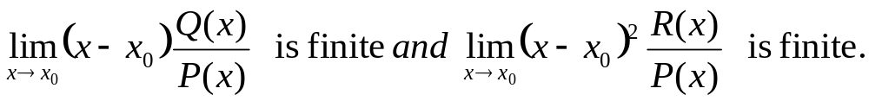
Classifying Singular Points
Our goal is to extend the method already developed for solving
near an ordinary point so that it applies to the neighborhood of a singular point x₀.
To do so, we restrict ourselves to cases in which singularities in Q/P and R/P at x₀ are not too severe, that is, to what might be called “weak singularities.”
It turns out that the appropriate conditions to distinguish weak singularities are

Slide 27
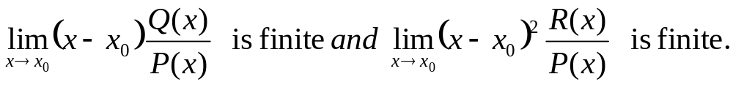
Regular Singular Points
Consider the differential equation
If P and Q are polynomials, then a regular singular point x₀ is singular point for which
Any other singular point x₀ is an irregular singular point, which will not be discussed in this course.

Slide 28
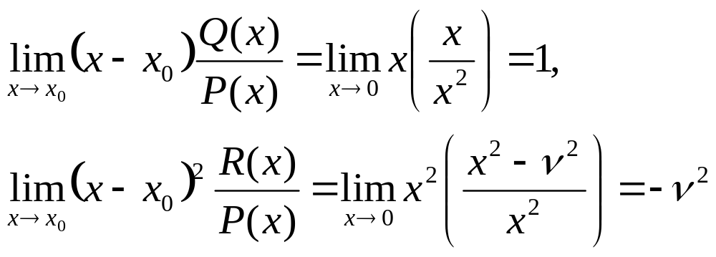
Example 4: Bessel Equation
Consider the Bessel equation of order ν
The point x = 0 is a regular singular point, since both of the following limits are finite:

Slide 29
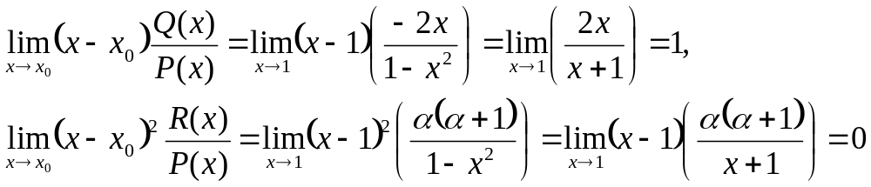
Example 5: Legendre Equation
Consider the Legendre equation
The point x = 1 is a regular singular point, since both of the following limits are finite:
Similarly, it can be shown that x = -1 is a regular singular point.

Slide 30
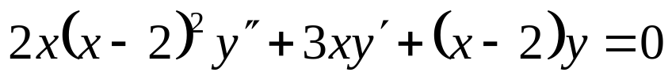
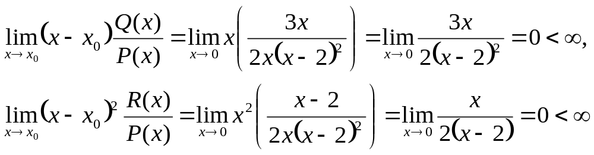
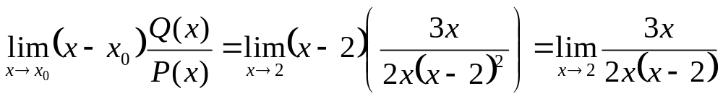
Example 6
Consider the equation
The point x = 0 is a regular singular point:
The point x = 2, however, is an irregular singular point, since the following limit does not exist:

